Slide 1

Presented by :Solomon Wegayehu
Musie Kebede
Tigist Ababaw
Mahider H/Mariam
Yezialem Asrat
Advisor : Dr. Dida Midekso

Slide 2
Why Online Exam?
Stored Repository of exams (Archived)
General problem with time for candidates
Timed question not possible
Auto result (and report)
Flexible
Time Saver
Security

Slide 3
Proposed Solution
It will be less time consuming and is more efficient.
Complexity is decreased in the proposed system as it is automated.
Results are very precise and will be declared in a very short span of time.
It is securing as unauthorized user no access to the system.
It generates reports and results.

Slide 4
Technologies Used
PHP
MySQL
HTML
JavaScript
CSS

Slide 5
Objectives
To design and develop the online examination system
To allow sector to create questions. questions can have multiple options.
To allow sector to create occupation. Occupation can be timed, occupation can have individual question timed , Each question in an occupation can have different marks. Same question in different occupation can have different marks and time.
To allow exam preparer to create exam and answer key.
To allow automatic result generation and report view.
To create the application according to OCACC rules and regulations

Slide 6
Problem
Candidate take the exam as scheduled.
PHP support only server side scripting
Security
Completely data base driven application (slow down the overall system in general)
Sequential generation of Exam question
Timed exams

Slide 7
Functional Requirement
Taking backup of the database, scheduling, security settings, editing/deleting/creating the database, adding or expelling sectors and occupations. And also setting passing mark.
Logging into the system, adding the candidate to a specific sector, creating/editing/deleting candidate groups, randomizing the questions and show answers in practice mode.
Creating a Exam, posting questions of exam, posting multiple options to respective questions and limiting time of the examination.
Requesting registration, updating user profile, selecting the test, printing the result at the end of the examination, changing password, resetting of forgotten password and checking the due date of the exam.

Slide 8
Non Functional Requirement
User interface and human factors
This online examination system has four types of users
Candidate
Sector administrator
Administrator and
Exam preparer.
The system will provide each user a particular interface and these interfaces have user interactive controls and pages that are user friendly and easy to use
The user interface provides the capability to search and generate reports from database and print the needed information.
The system notifies the user when an error occurs. Hence, the user only needs to have basic knowledge of computer.

Slide 9
Nonfunctional requirement (cont...)
Documentation
In order to make the users to better interact with the system, there will be a user manual. This describes the overall detail steps of the system with the perspective of each user.

Slide 10
Nonfunctional requirement (cont...)
3.3.4 Performance characteristics
Speed is one of the performance characteristics of a web based application. Since it is an online examination, the users can access the system concurrently. Due to this fact it should be very fast with maximum throughput.
3.3.5 Error handling and extreme conditions
The system responds to an input error and displays message to the user. The error will be handled by error catching. In case of extreme condition, the administrator can recover the system from a backup in a short period of time.

Slide 11
Nonfunctional requirement (cont...)
3.3.6 Security and system protection
We have to implement security techniques in our system, such as authentication, antivirus and firewalls. This feature helps the system to be more reliable and secure.
3.3.7 System Modifications
The system is easy to modify and extend as object oriented approaches are used.
3.3.8 Physical Environment
The server should be in a secured environment where there is proper air conditioning. While the candidates computers should be in optimum distance during examination.

Slide 12
Nonfunctional requirement (cont...)
3.3.9 Security Issue
Application will allow only valid users to access the system. Access to any application resource will depend upon user’s authentication through username and password in order to prohibit an unauthorized access.
3.3.10 Resource and Management Issue
After completion of the system development, the program will be installed by the group and the group will provide training for the company

Slide 13
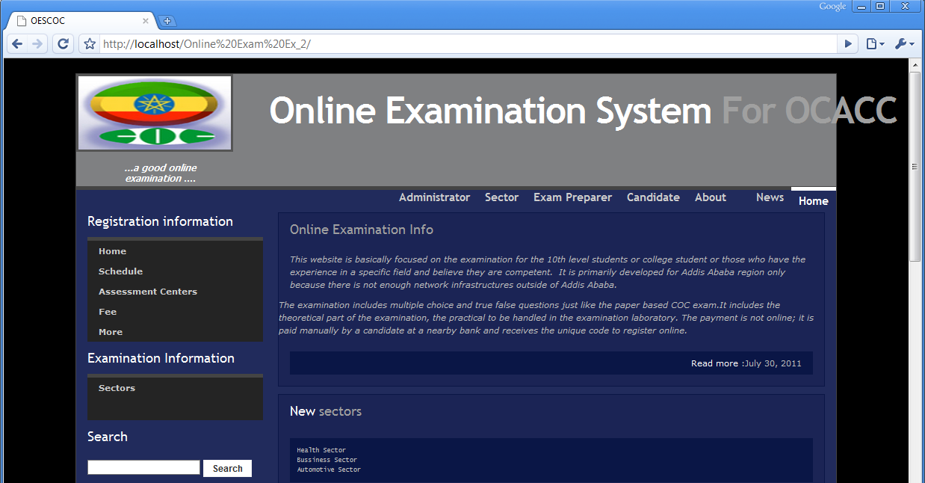
Home Page

Slide 14
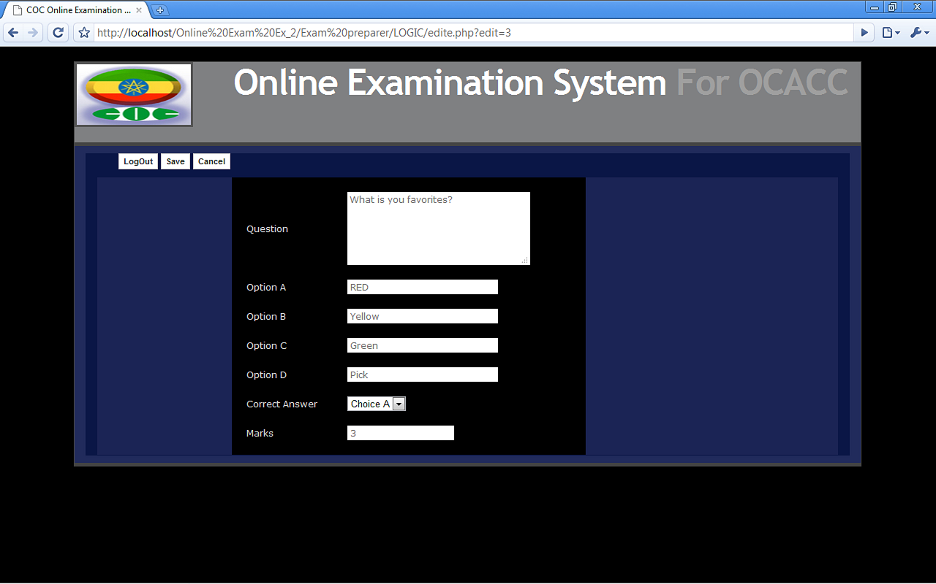
Exam Prepare page

Slide 15
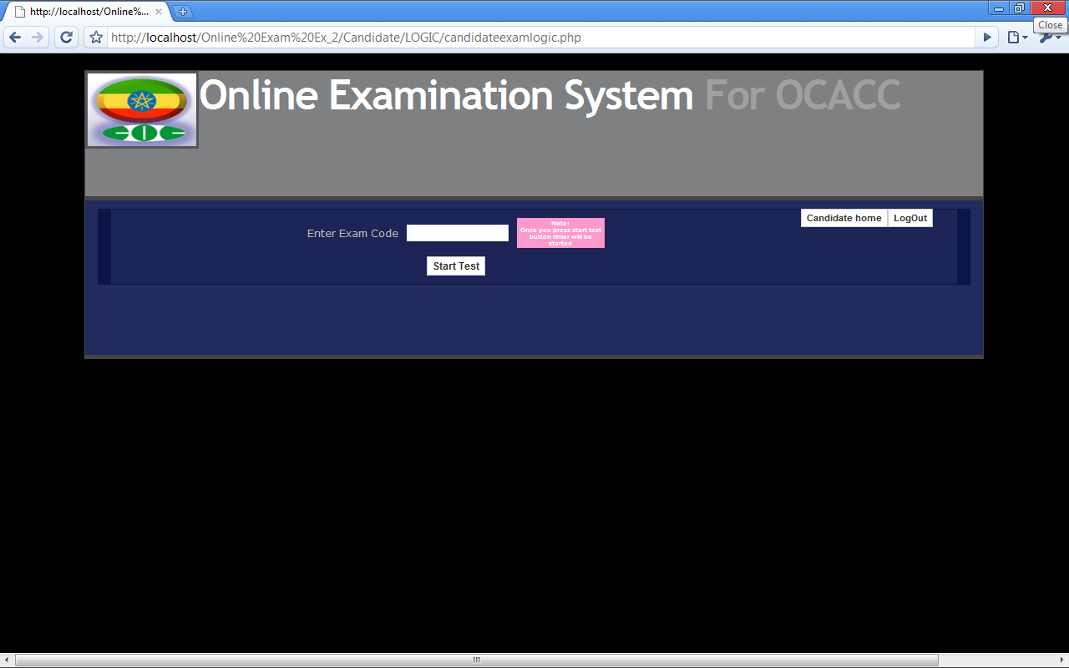
Exam Selection Page

Slide 16
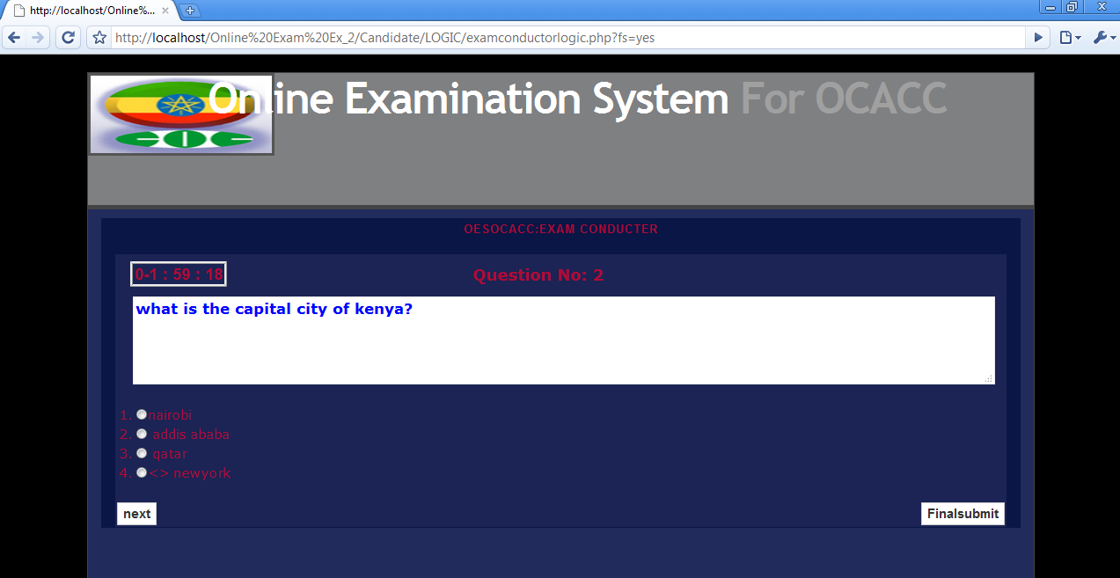
Exam Tacking Page

Slide 17
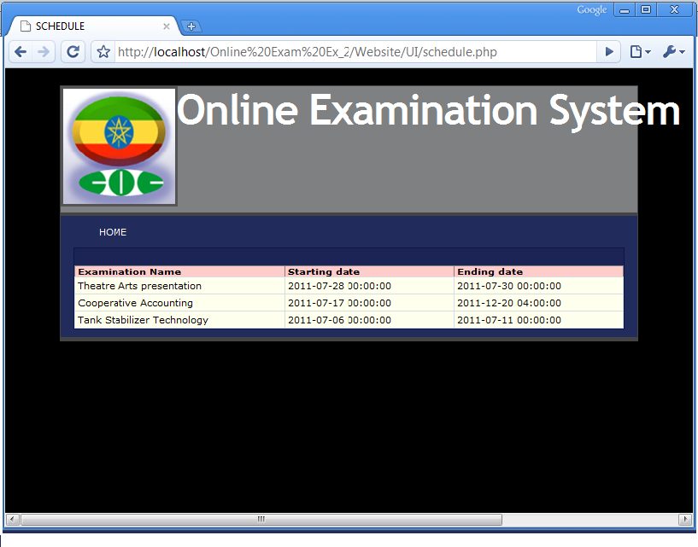
EXAM START AND END DATE

Slide 18
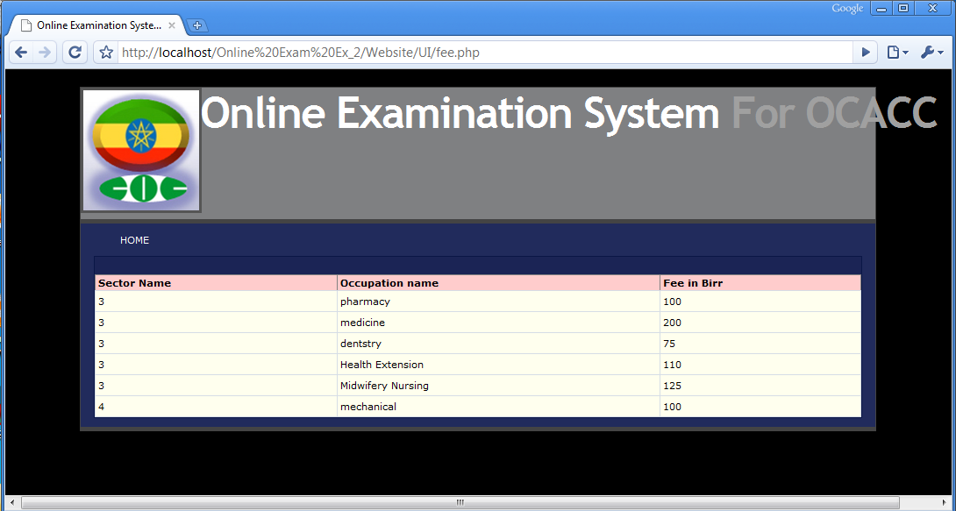
SECTOR OCCUPATION AND FEE PAGE

Slide 19
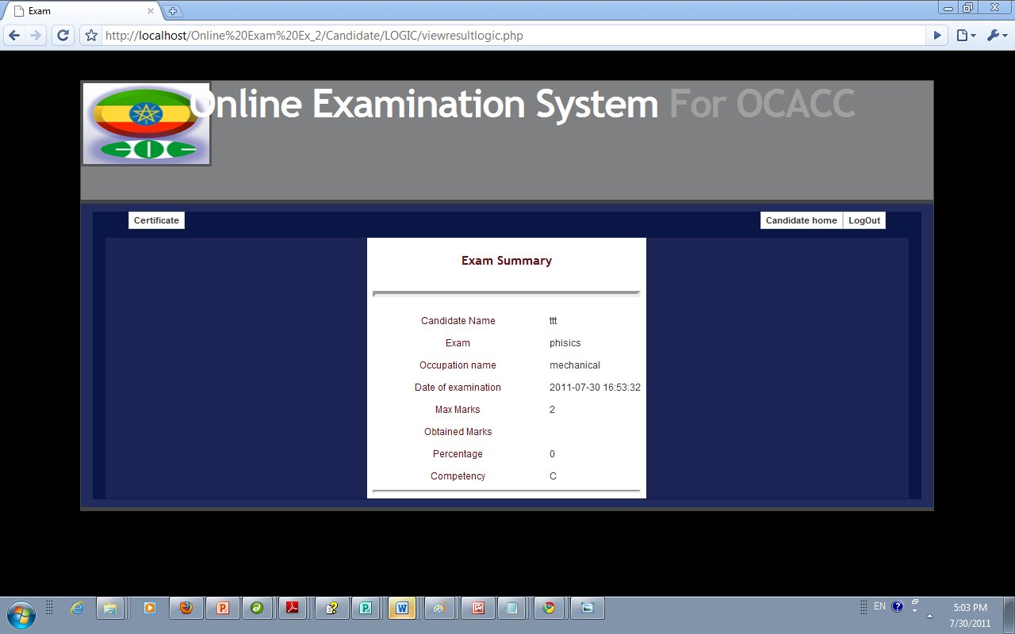
Exam Summary

Slide 20
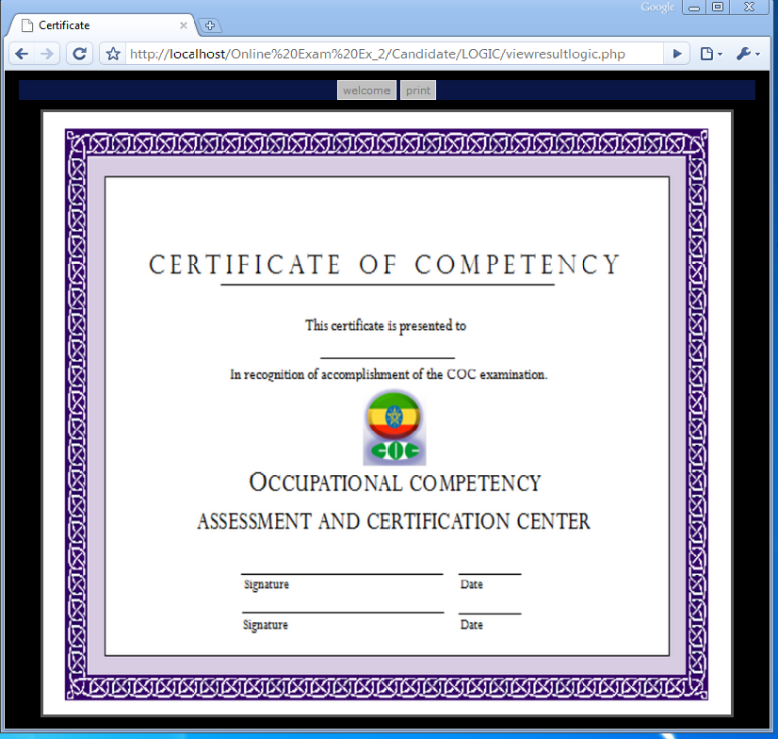
CERTIFICATE OF COMPETENCY

Slide 21
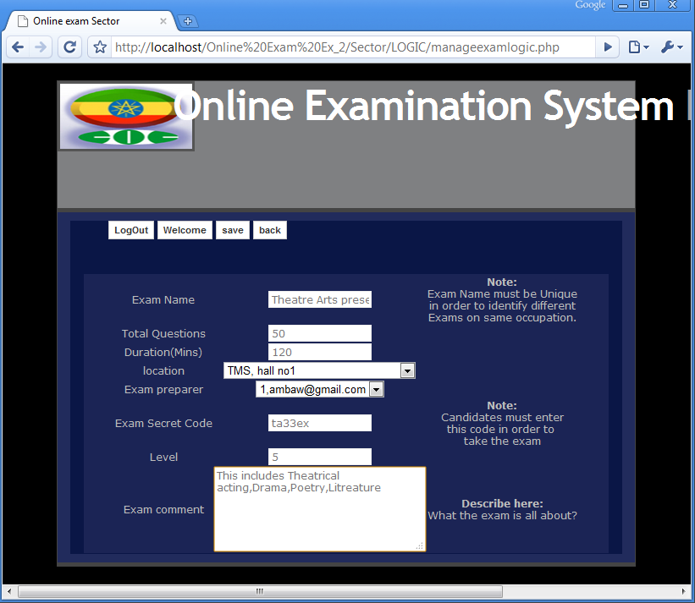
COMMENTE PAGE

Slide 22
Demo

Slide 23
Questions?

